Slide 1

Phishing Awareness Training
Recognize and Avoid Phishing Attacks
Sikriti Modak

Slide 2
Agenda
Introduction
Types of Phishing Attacks
Recognizing Phishing Attacks
Summary and Key Takeaways
Analyzing Phishing Attacks
Presentation Title

Slide 3

Introduction
Phishing is an attempted theft online that involves deceiving people into giving out their private details like passwords, credit card information etc. Such kinds of assaults happen when fraudsters pretend to be trustworthy sources on the internet in order to trick their victims into giving them the necessary personal data. The most common form of phishing attacks is done using emails while others can include SMSs; Facebook posts among other posts made by hacking their accounts.

Slide 4
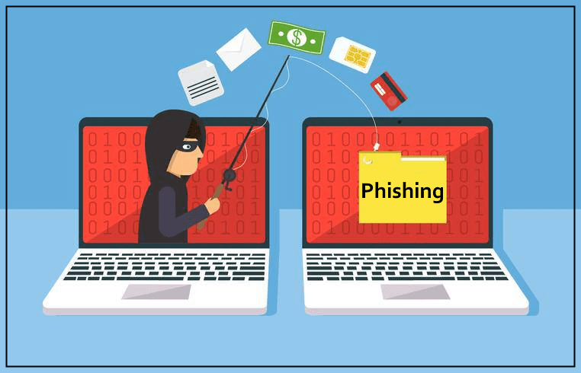

Email Phishing
Spear Phishing
Whaling
Smishing (SMS Phishing)
Vishing (Voice Phishing)
Types of Phishing
This Photo by Unknown Author is licensed under CC BY-NC-ND

Slide 5

Explanation: Attackers send fraudulent messages designed to trick recipients into revealing personal information, such as passwords or credit card numbers.
Example: An email that appears to be from a trusted bank asking you to verify your account information.
How Phishing Works
This Photo by Unknown Author is licensed under CC BY-SA

Slide 6
Common Features of Phishing Emails
Unfamiliar Sender | Emails from unknown senders or slight variations of known addresses.
Urgency or Threats | Messages that create a sense of urgency or fear.
Suspicious Links | Links that don’t match legitimate URLs.
Attachments | Unsolicited attachments, often with executable files.
Grammar and Spelling Mistakes | Poorly written content.
Request for Personal Information | Asking for sensitive details that legitimate companies wouldn't ask via email.

Slide 7
Recognizing Phishing Websites Check the URL: Ensure it matches the legitimate site. HTTPS: Look for HTTPS and a padlock symbol in the address bar. Design Quality: Poor design or low-quality logos can be a red flag. Unsolicited Prompts: Be cautious of unexpected pop-ups or prompts for personal information.

Slide 8

Social Engineering Tactics
Impersonation: Attackers pretend to be someone you know.
Baiting: Offering something enticing to get you to give up information.
Pretexting: Creating a fabricated scenario to steal information.
Tailgating: Physically following someone into a restricted area.

Slide 9



Real-Life Phishing Examples
Example 1:
A phishing email disguised as a message from PayPal.
Example 2:
A phishing website imitating a bank login page.
Example 3:
A spear-phishing attack targeting a company executive.

Slide 10


Summary
The ability to recognize and avoid phishing attacks is relevant for the protection of personal and organizational security in the modern environment. Successful phishing results due to human trust and negligence from technique by which attackers act as trusted entities for eliciting confidential information. That is, practicing awareness of common indicators of phishing, such as links, urgency, and ill-written messages, and being cautious about social engineering methods greatly reduce vulnerability. Other proactive measures are taken to check on the identity of the senders, the URLs should be checked before opening, avoid revealing sensitive personal information over the internet, and always updating security software. Reporting suspected phishing attempts promptly and learning about new threats constitute further important points in reducing risks and maintaining robust security defenses.

Slide 11




Thank you
Sikriti Modak

